Slide 1
Census 2020 in Alameda County Community Health Center Staff Training
Alessia Simmonds, Outreach Manager
Alessia.Simmonds@acgov.org
www.acgov.org/Census2020

Slide 2
In just 52 days, Census notices will arrive!

Slide 3
What is Census 2020?
The census is a mandated count by the federal government taken every ten years of EVERY person living in the United States, regardless of age, sex, ethnicity, citizenship or immigration status.
Census 2020 is our one chance to determine how our collective money and political power will be distributed until 2030.

Slide 4
What will the Census Ask?
How many people live at the address
Whether the home is owned or rented
Name
Phone number
Sex
Age and date of birth
Ethnicity
Race

Slide 5
Census Questionnaire for: 1234 Census Street
Don’t forget anyone!
This census must count ALL residents regardless of relationship including:
Grandpa upstairs
Friends renting the garage
Extended family
Babies born on or before Census Day
COUNT EVERYONE!
General Rule: Count people at their usual residence, which is the place where they live and sleep most of the time.
Note: People who do not have a usual residence, or who cannot determine a usual residence, are counted where they are on Census Day – April 1st
Count every adult, child & baby @ each mailing address

Slide 6
Census Confidentiality
Your census responses are totally confidential
Extremely strong laws protect the confidentiality of your census response.
The Census Bureau is not allowed to share your personal information with anyone, including ICE, police, or any other government agencies.
The Census Bureau can only use your response to create general information about the population, like how many people live in your city, and statistics about age, gender, and race. The Census Bureau cannot share information about you as an individual.

Slide 7
Measures to Protect Census Information
Title 13, U.S. Code
The Census Bureau is bound by Title 13 of the United States Code which provides the following protections:
Private information is never published. It is against the law to disclose or publish any identification information or share data with another governmental agency.
Census Bureau employees are sworn to protect confidentiality. People sworn to uphold Title 13 are legally required to maintain the confidentiality of your data. Every person with access to your data is sworn for life to protect your information and understands that the penalties for violating this law are applicable for a lifetime.
Violating the law is a serious federal crime. Anyone who violates this law will face severe penalties, including a federal prison sentence of up to five years, a fine of up to $250,000, or both.

Slide 8
Power of the Census – by the Numbers
~60% of Alameda County resources are determined by the Census Data | Each person missed =~$1,000 lost in funding PER PERSON PER YEAR FOR 10 YEARS | An undercount of 6% = loss of $1 Billion over 10 years | Resources pay for education, housing, roads, health care, social services, and more!

Slide 9
How Does the Census Impact Heath?
Funding for community health centers is informed by Census Data
Census data is used for everything from research and quality improvement to needs assessments and staffing decisions
Hospitals and families rely on programs, including Medicaid; Head Start; Women, Infants and Children (WIC) and others whose funding is determined by census data.
Childrenshospital.org

Slide 10
The 2020 Census is Radically Different
Fear and Distrust Distrust of government - Privacy concerns - Previously proposed citizenship question - U.S. GAO predicts a 17% reduction in self-response | First Digital Census First to be conducted primarily online - Cyber security concerns - Available on mobile devices | Cuts in Federal Funding Census Bureau has limited resources and staffing - Only one Census test - Less follow-up visits - Challenges in hiring enumerators | Language Barriers Unavailable in some County languages - 13 languages online and by phone - 59 languages by video and glossary guides based on national needs

Slide 11
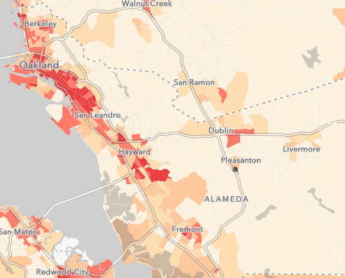
Alameda County is Hard to Count
Young children
Large or overcrowded households
Senior citizens
Foreign born residents / Immigrants
People of color
Renters / Frequent movers
‘Linguistically isolated’ households
Households without a computer or internet access
People who have been
or could be targets
of law enforcement
Low-income households
Unhoused individuals
People without high school diploma
People with disabilities
26%
of Alameda County is “Hard-to-Count”

Slide 12
Outreach Framework
Alameda County Complete Count Committee
Communications
Training
Materials
Community Partners Direct Outreach through trusted messengers
Questionnaire Assistance Centers
Know Your Rights Workshops
Census Events
Notes:
Our outreach framework was developed to make it easy for our partners to lead direct outreach by equipping them with communications, trainings, and materials.

Slide 13
Census 101 Wrap up
Trusted Messengers are CRITICAL to ensuring OUR COMMUNITY get the
DATA, DOLLARS, and DECISION MAKERS we deserve!

Slide 14
Counting People Experiencing Homelessness
Service Based Enumeration
Group Quarters
Enumeration of Transitory Locations
Soup kitchens
Shelters
Motels
SRO’s
RV Camps
Encampments
Mobile food vans
Outstanding Questions from Alameda County:
What are the staffing levels for these enumeration operations?
How much time will be allotted to this operation? (days / hours)
Will the Bureau hire staff who have experience working with this population?

Slide 15
Census Jobs
Apply today!
Best to apply before 12/31/19
Job Details:
Enumerators work remotely using a provided mobile device
Pay: $25 per hour
Application online now through – December 2019
Over 700 enumerators will be hired throughout Alameda County to work between April – July 2020
County and Census staff will hold info sessions/application workshops or job seekers in Fall of 2019
Eligibility
Must be 18
Must have access to a vehicle or reliable transportation
Males born after 1959 must be enrolled in the Selective Service Program
The Census Bureau will perform background checks on approved applicants (Formerly incarcerated individuals are encouraged to apply)
https://2020census.gov/jobs

Slide 16
Timeline
Phase | Census Activity
Awareness & Preparation January – March 11th | Program Implementation Advertising & Local media coverage – State & Fed Trainings – Alameda County
Motivation I March 12th – April 30th | Self Response begins Census response invitations sent between March 12th and March 20th Group Quarters and SBE Operations
Motivation II May 13th – July 31st | Non-Response Follow-up

Slide 17
Thank You!
Alessia Simmonds, Outreach Manager
Alessia.Simmonds@acgov.org
www.acgov.org/Census2020

